Slide 1
Urban Air Quality and Health Impact Analysis
Project 1
Team 2
Abhilasha Singh Aswin Balaji Thippa Ramesh Lixing Pan
IDS 6101

Slide 2

Purpose
Formulating SMART, research-driven questions.
Conducting thorough Exploratory Data Analysis (EDA)
Applying relevant statistical tests.
Presenting findings and conclusions.

Slide 3
Smart Questions
How health risk scores differ between weekdays and weekends?
Analyzing how key meteorological factors vary across different cities.
Investigating the key meteorological factors that significantly influence health risk scores?
How changes in humidity might affect overall health?
Examining how wind speed and health risk scores vary over days.

Slide 4
Exploratory Data Analysis (EDA)
Understand the Dataset and its Structure
Categorizing Variables
Handling Missing Values
Detecting Outliers - Boxplot
Univariate Analysis - Histogram and Bar plots
Bivariate Analysis (Analyzing Two Variables Together) - Scatter plot
Multivariate Analysis (Analyzing More Than Two Variables) - correlation matrix heatmap

Slide 5
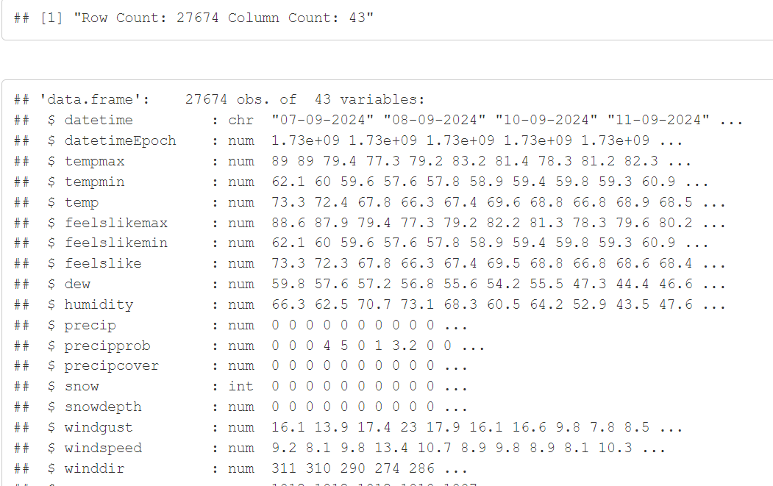
Exploratory Data Analysis (EDA)
Dataset Loading and Details
Insight: Collection of 27674 observations related to weather and its potential health impacts across major seven U.S. cities.

Slide 6
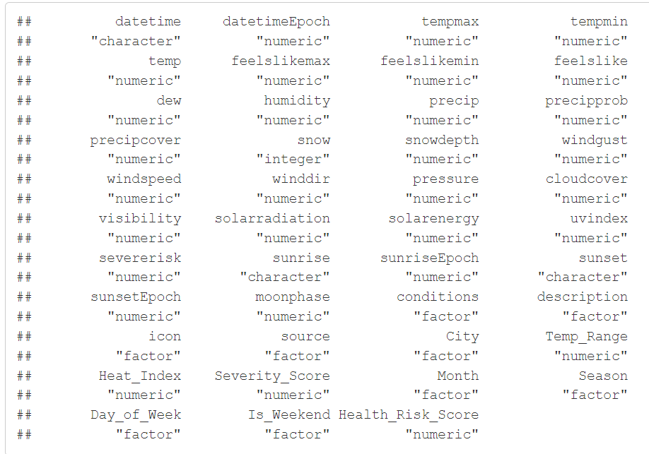
Exploratory Data Analysis (EDA)
Appropriate Datatype Conversion
Insight: Out of 43 variables, 9 variables are factor, 30 are numeric, and 3 are character.

Slide 7
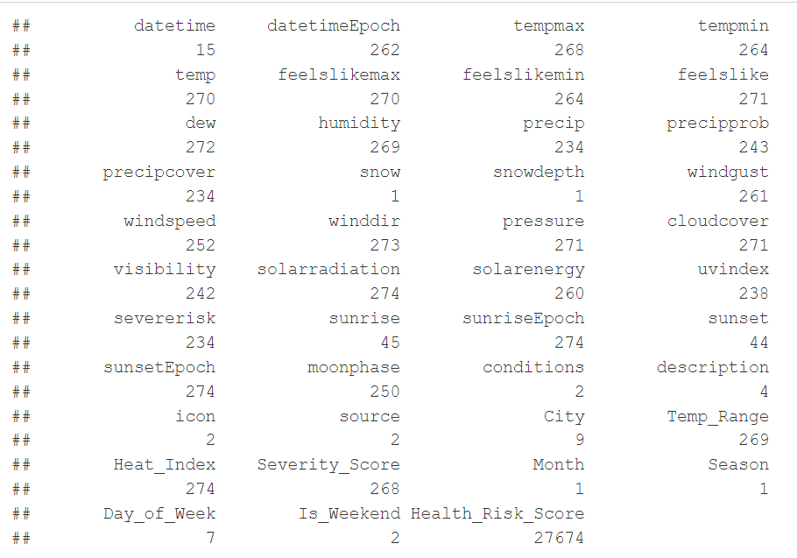
Exploratory Data Analysis (EDA)
Dropping Unwanted Column
Insight: Dropping season , snow, snowdepth and month columns as they have single value.

Slide 8
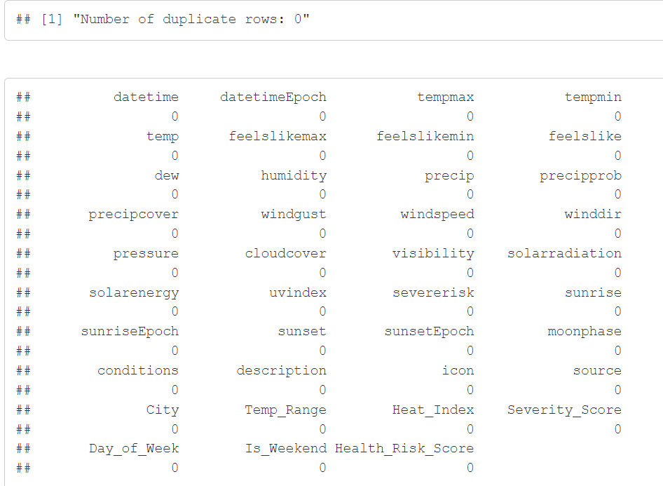
Exploratory Data Analysis (EDA)
Missing values
And duplicate rows
Insight: No missing values and duplicate rows

Slide 9
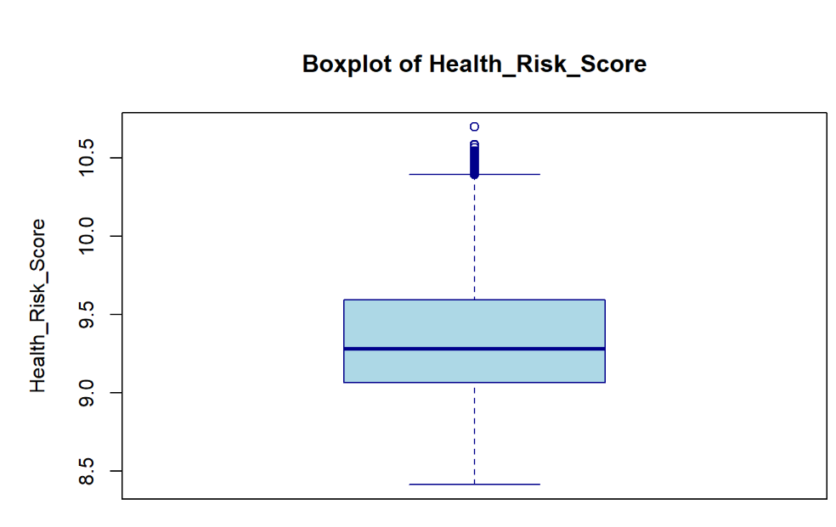
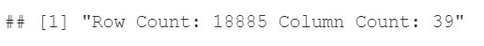
Exploratory Data Analysis (EDA)
Removing Outliers
Insight: After removing the outliers, we are left with 18885 observations

Slide 10
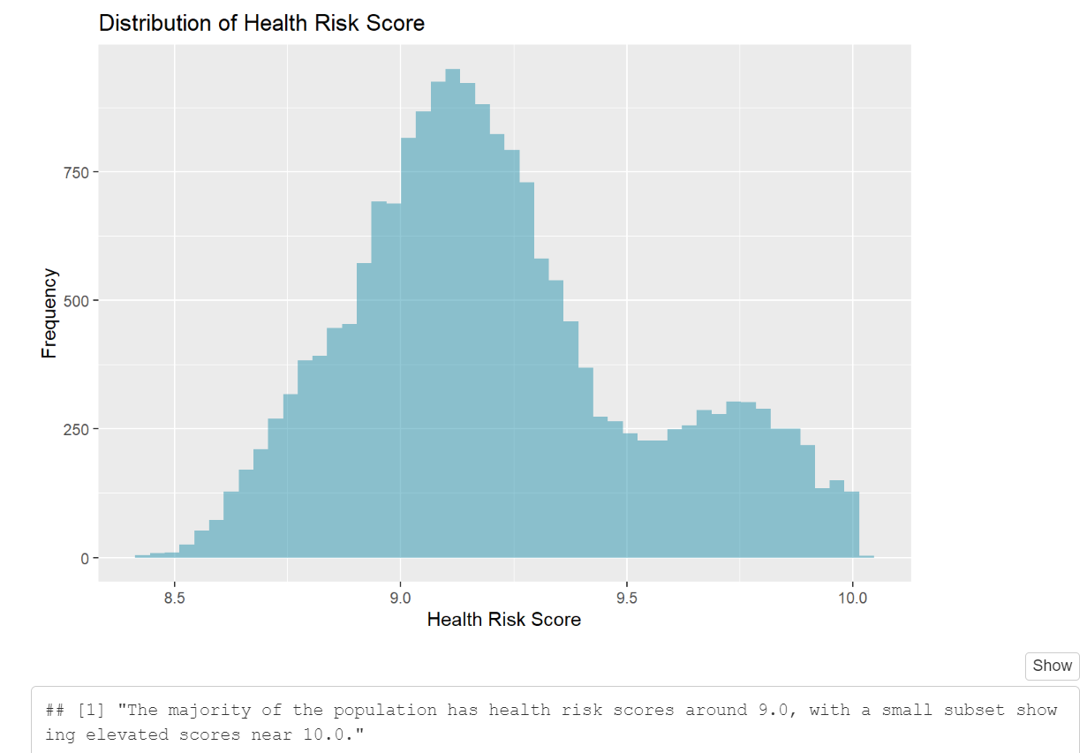
Exploratory Data Analysis (EDA)
Univariate Analysis
Insight: Most of the population has health risk scores around 9.0, with a small subset showing elevated scores near 10.0.

Slide 11
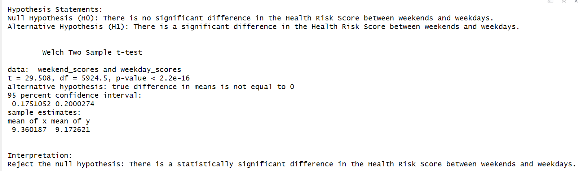
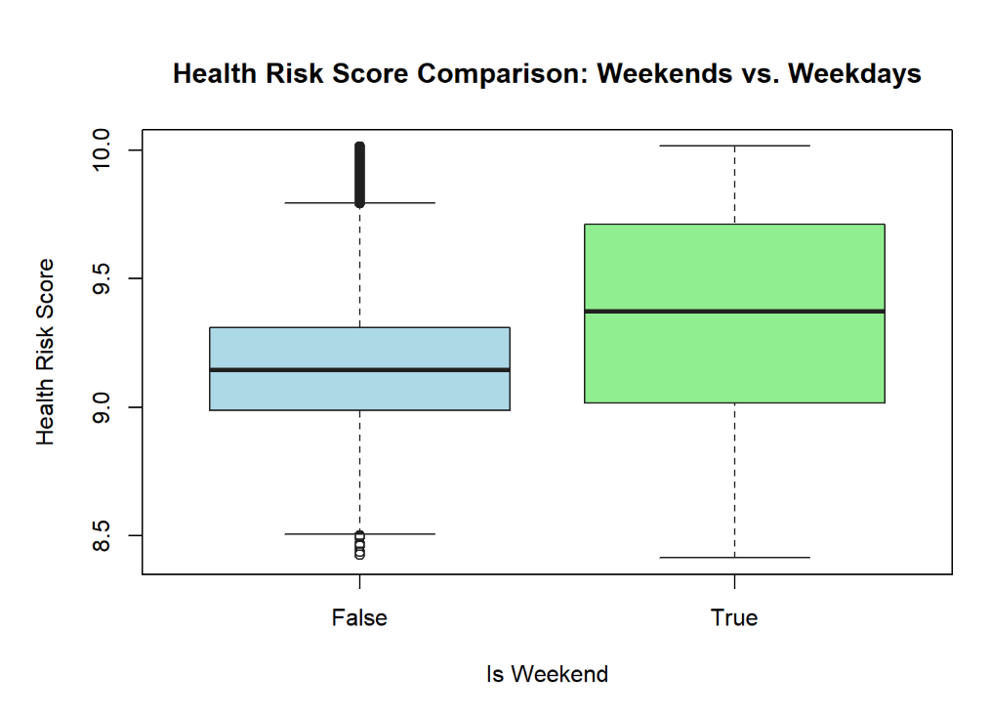
Exploratory Data Analysis (EDA)
How health risk scores differ between weekdays and weekends?
Insight:
There is a significant difference in Health Risk Scores between weekends and weekdays. Scores are generally higher on weekends than on weekdays, indicating increased health risks during weekends

Slide 12
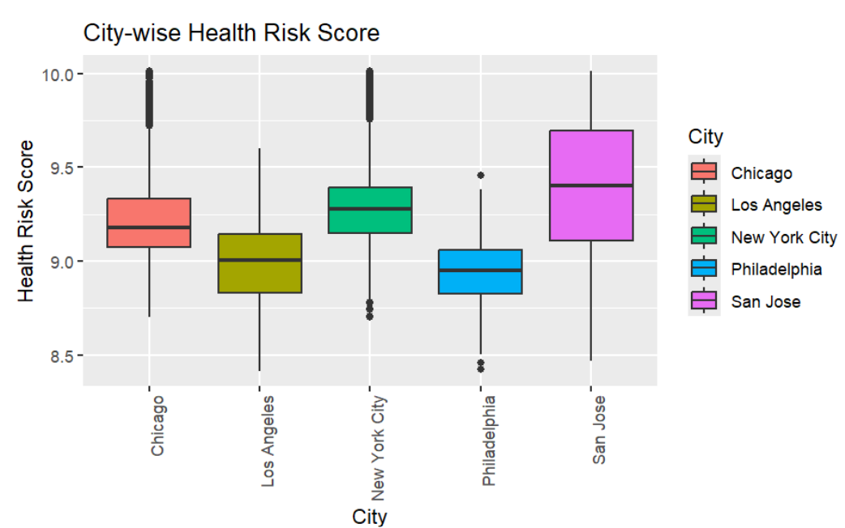
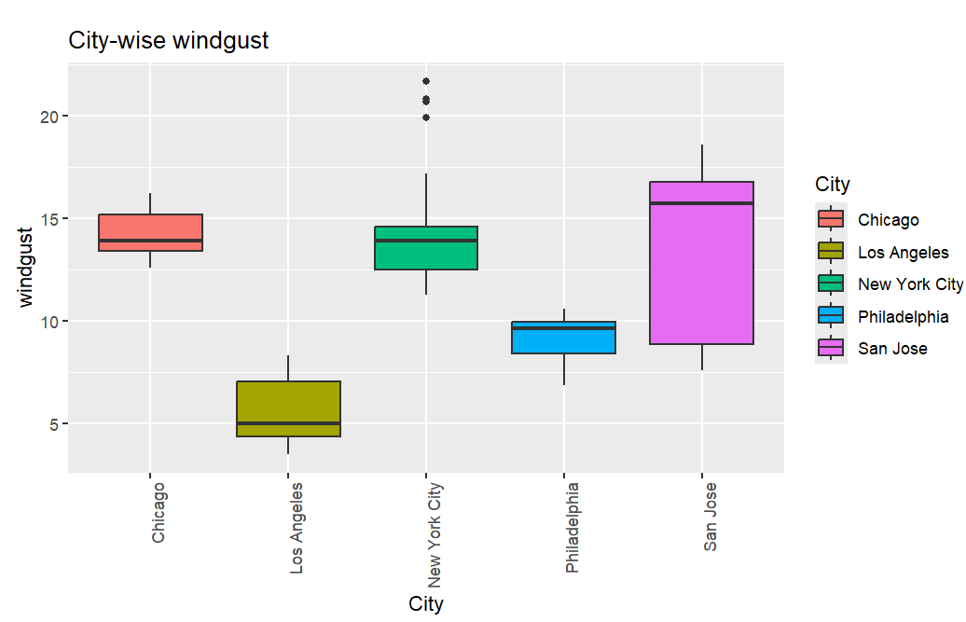
Exploratory Data Analysis (EDA)
Analyzing how key meteorological factors vary across different cities.
Insight:
San Jose has the highest health risk score and wind gusts, while Philadelphia shows the lowest health risk score and Los Angeles the lowest wind gusts.

Slide 13
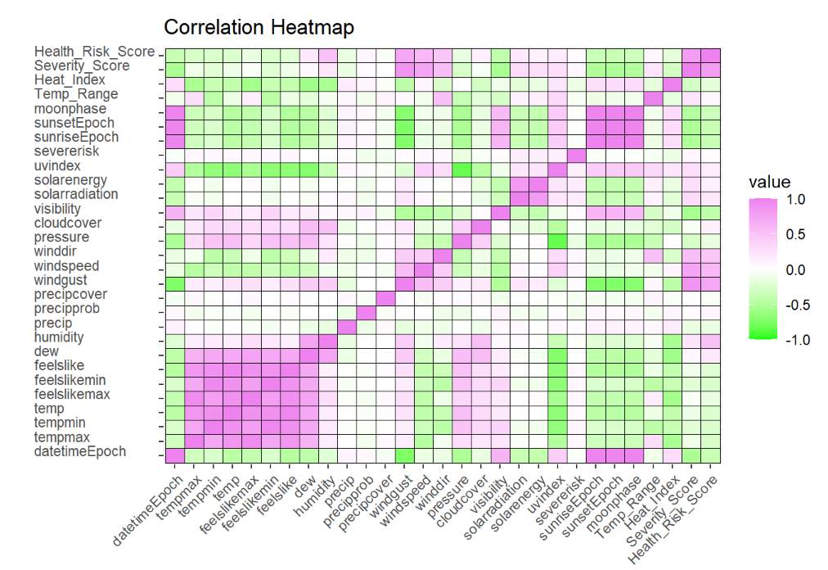
Exploratory Data Analysis (EDA)
Correlation heatmap
Insight: Visualize the strength and direction of relationships (correlations) between pairs of variables in a dataset

Slide 14
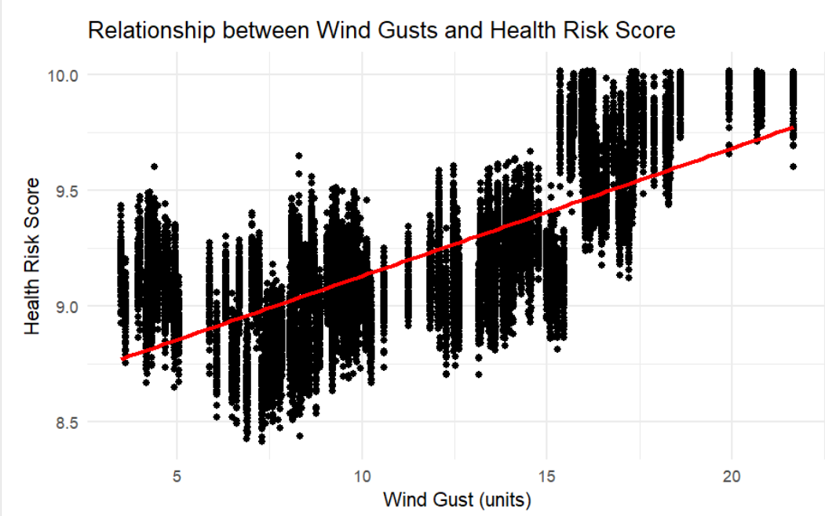
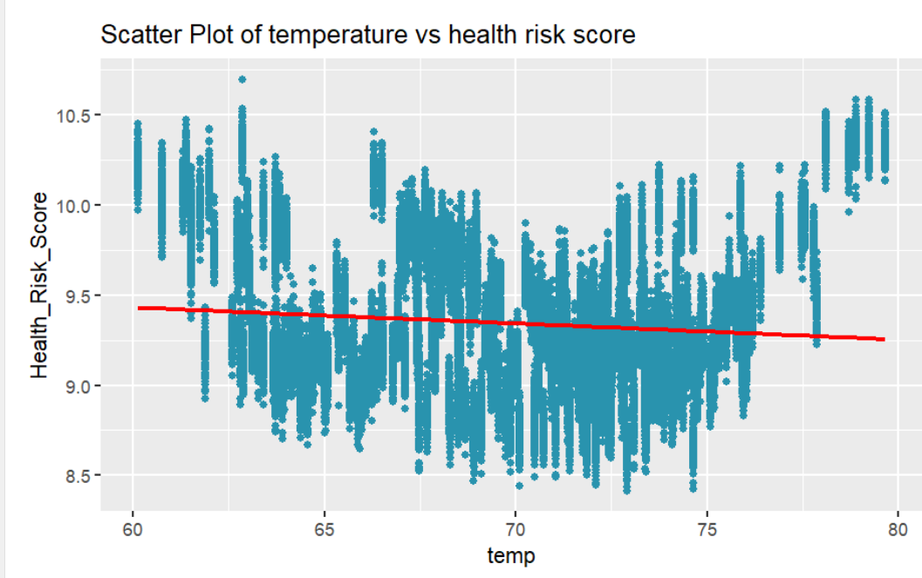
Exploratory Data Analysis (EDA)
Investigating the key meteorological factors that significantly influence health risk scores?
Insight:
Wind gusts have a positive impact on health risk, whereas temperature has a weaker, slightly negative relationship with health risk scores.

Slide 15
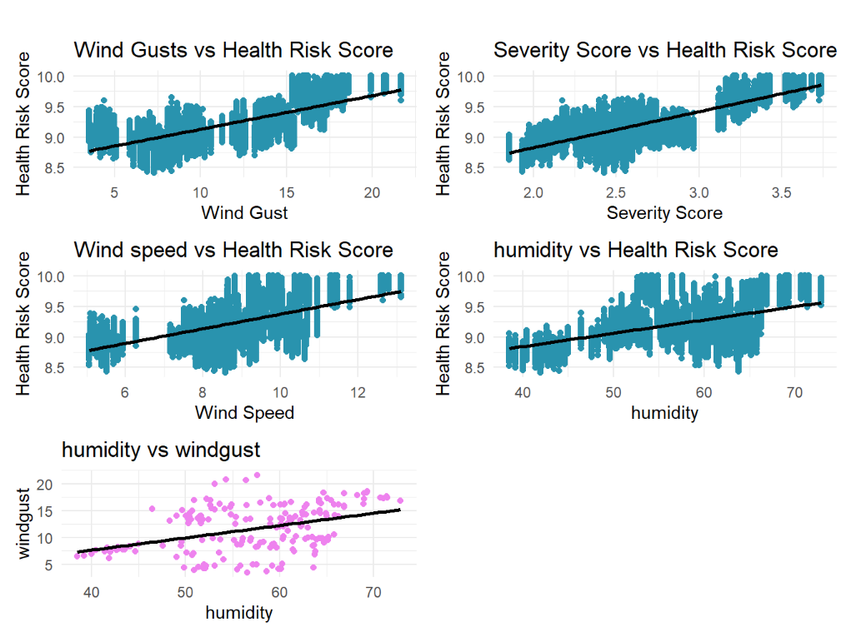
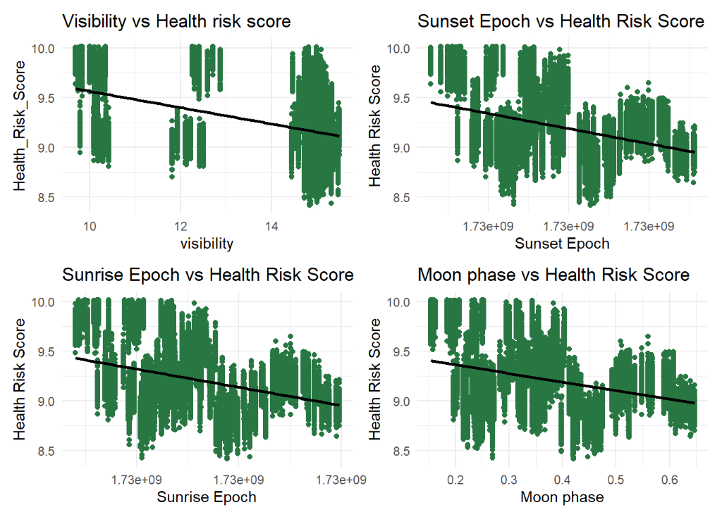
Exploratory Data Analysis (EDA)
How changes in humidity might affect overall health risk?
Insight:
Wind-related factors (gusts and speed) and humidity increase health risk scores, while factors like visibility, sunrise/sunset times, and moon phases reduce them.

Slide 16
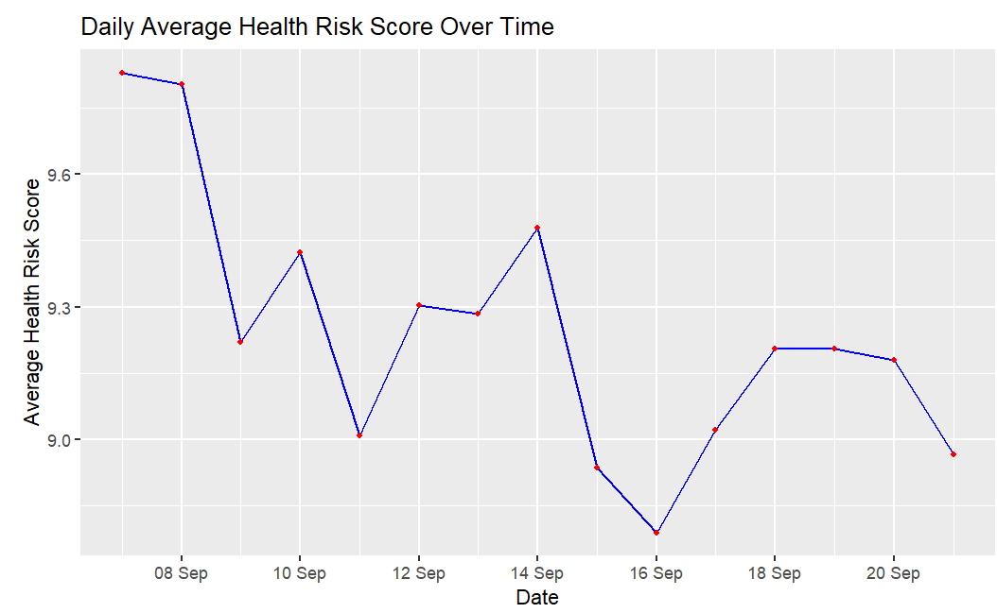
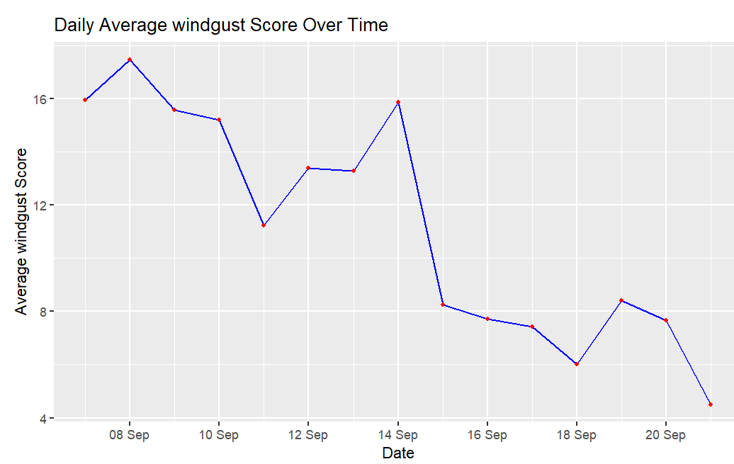
Exploratory Data Analysis (EDA)
Examining how wind speed and health risk scores vary over days.
Insight:
Both health risk and wind gust scores fluctuate similarly over time, peaking around September 8th and declining sharply by mid- September. Health risk score is being influenced by windgust.

Slide 17
Conclusion
Health Risk Variation: Health risk scores are higher on weekends compared to weekdays, indicating greater risks during weekends.
City Comparison: San Jose has the highest health risk and wind gusts, while Philadelphia shows the lowest health risk.
Meteorological Impact: Wind gusts significantly increase health risk scores, while temperature has a weaker influence.
Humidity and Health: Health risk scores fluctuate with changes in wind gusts, peaking in early September.
Key Factors: Wind-related factors increase health risks, while visibility and sunrise/sunset times lowers them indirectly.

Slide 18

Any thoughts or questions?

